Slide 1
Zippy Publishing CRM Implementation
By: Isaiah Nazaire, Kyle Johns, Chase Hunter, Allen Bryan

Slide 2
Background of Zippy Publishing
Growing eBook business founded in 2017 based in Gainesville, GA
Mission: creating opportunities for connecting, changing, and improving lives through reading
50 Employees, 10 Sales
Revenue: $1 million
Offers eBooks and online magazines, as well as Editing and publishing services

Slide 3
The Problem with Zippy Publishing
Growing rapidly since the second year of operation
Having difficulty leveraging employees effectively
Having difficulty managing new and existing customer relationships
Decreasing profitability

Slide 4
Purpose
The implementation of the new CRM solution for Zippy Publishing was brought to life to solve the most critical challenges Zippy Publishing has encountered thus far.
The Company is struggling with maintaining a competitive business model due to internal struggles:
Leveraging Employees
Profitability
Managing Customer Relationships
As an organization, we are implementing measurable goals to determine the success or failure of our CRM implementation. These measurable goals will aid our team in determining what is working, as well as what is not working, regarding the new CRM solution.

Slide 5
Measurable Goals / Success Criteria
Zero delays in eBook deliveries
Consistent increase in new customer relationships - with a goal of at least five new customers every other week and one new author available for purchase
Gradual rise in profitability after CRM implementation - with a goal to reach a 10% increase in profitability within three months after implementation of CRM

Slide 6
Project Approach
We plan to slowly implement the professional version of Salesforce. The deployment will be over a three-month period and will be implemented only for sales employees. This will provide features such as task management, customizable sales processes, mass emailing, and more which will allow our employees to better leverage their skills. We will complete the following steps in order when implementing this CRM
Begin with purchasing the CRM and ensuring that it is properly installed and running on company devices.
We will then begin training our sales employees on how to use the software.
Next, we will monitor and receive feedback from our end users and benchmark their understanding of the CRM
In closing, we will make Salesforce Professional version available to the functional managers to provide all the information needed to their staff

Slide 7
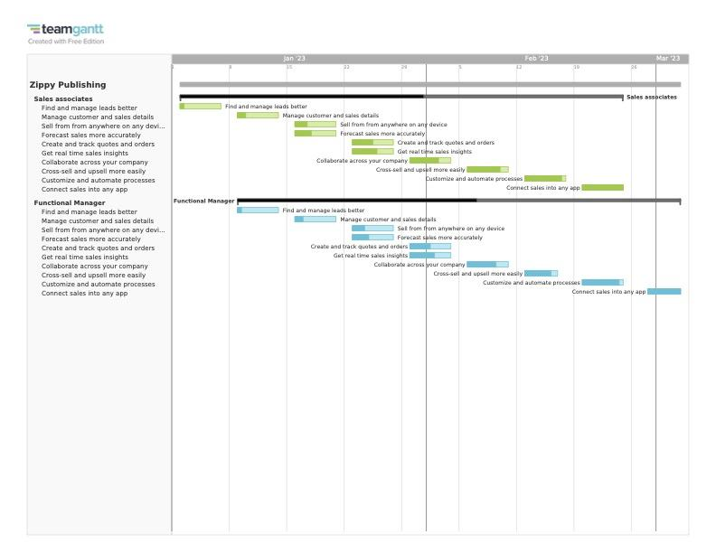
Original scope
Original Scope is the first 9 weeks of 2023
The main purpose was to get Sales and Functional managers to learn CRM
Functional Managers will be a week behind sales
Information on would flow to departments

Slide 8
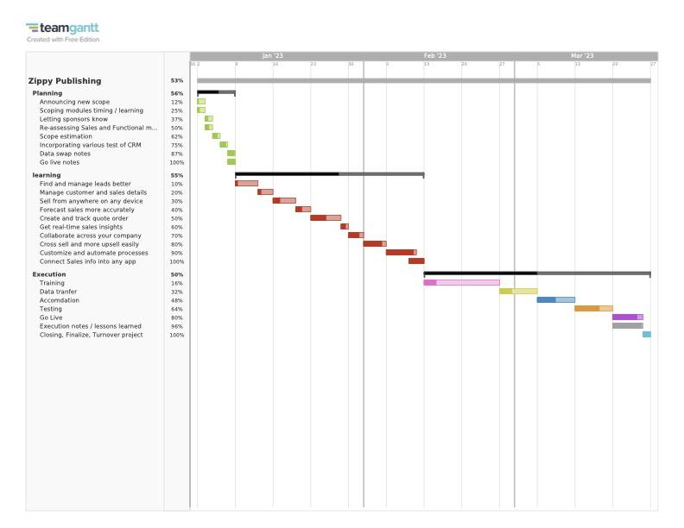
New Scope
Roadmap is in accordance to Project management life cycle
Re-scoped to 3 months
Replanning and accordance with higher management
Each module of Salesforce professional
Training two weeks
Accommodation of new CRM System for users
Testing for full functionality
Go live

Slide 9
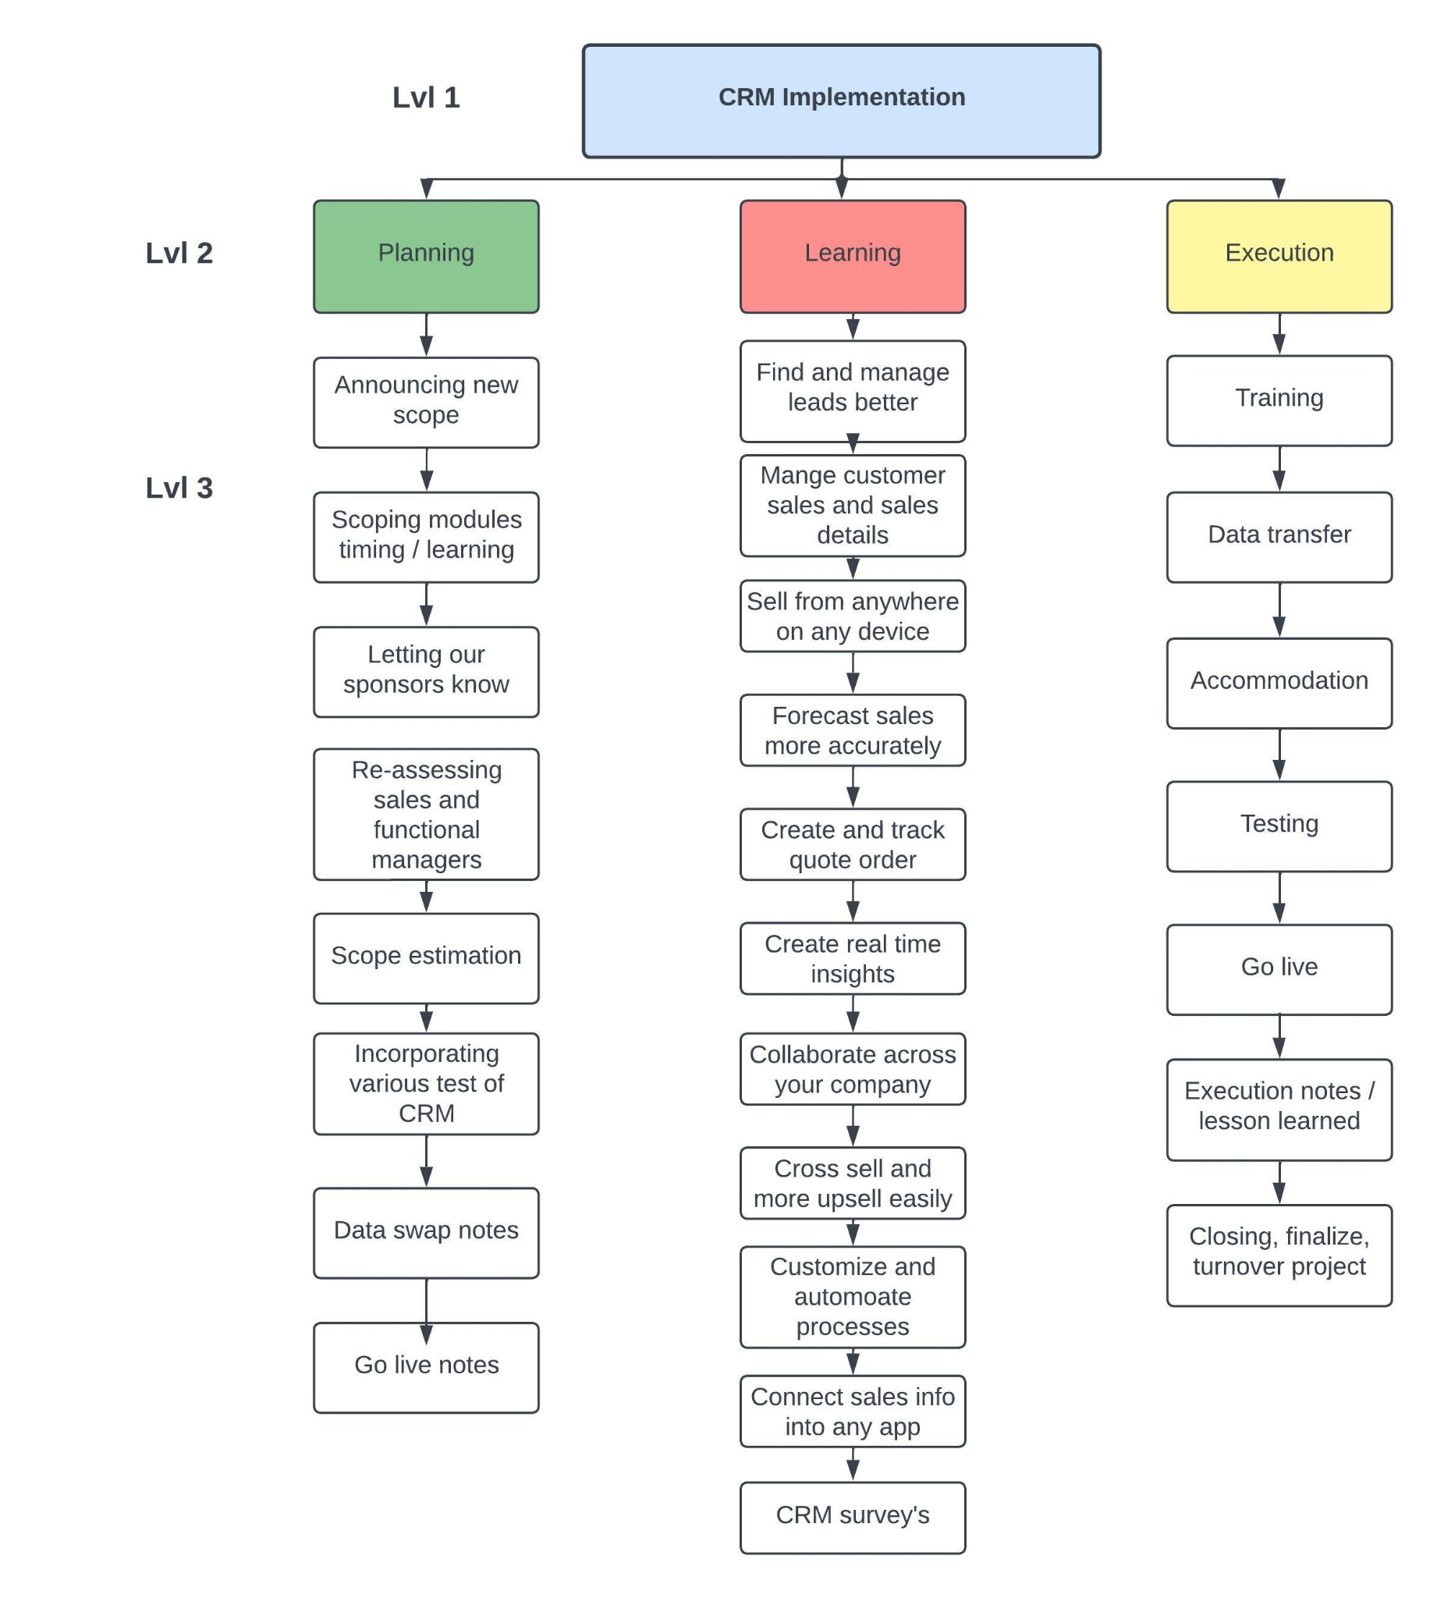
Work Breakdown Structure
Level 1 overall implementation
Addressing stakeholders and those involved within planning
The modules of the professional version
Surveys of the implementation closes out this phase
After learning throughout all the modules the training will begin for users
While users learn they will transfer their old data over
Execution notes
Turnover to project

Slide 10
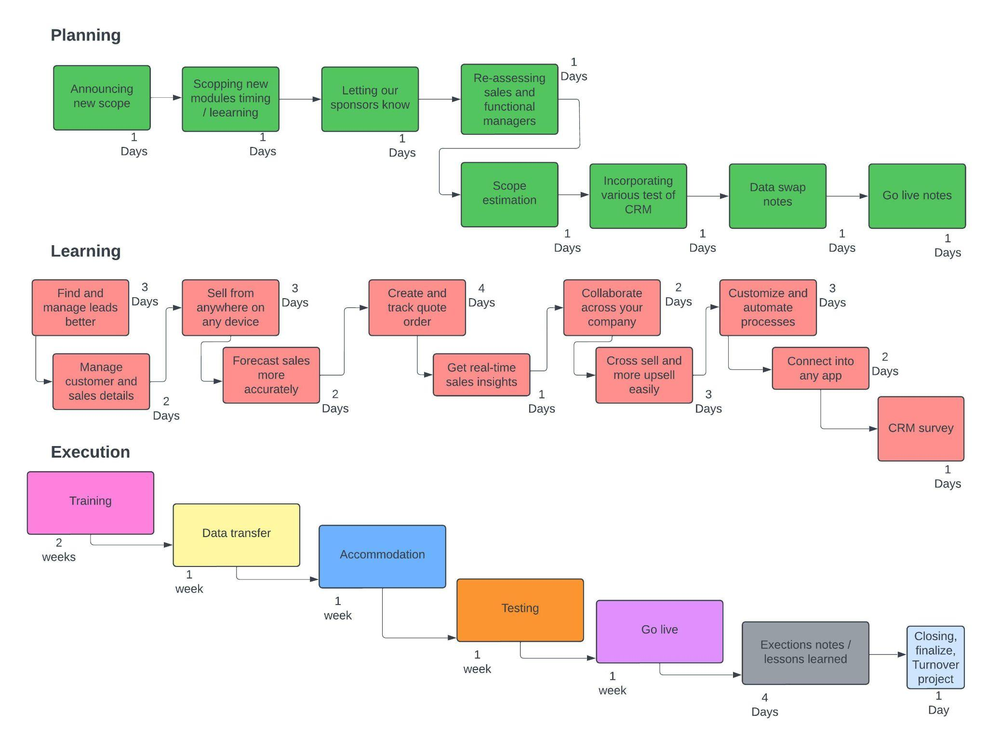
Critical Path Diagrams
Planning will be simple, re-evaluating upper management
Learning will be dependent on the size of the modules
We will give users two weeks time to fully try to understand the CRM
Execution will take place the last week
Closing, turnover to zippy will be the 90th day

Slide 11
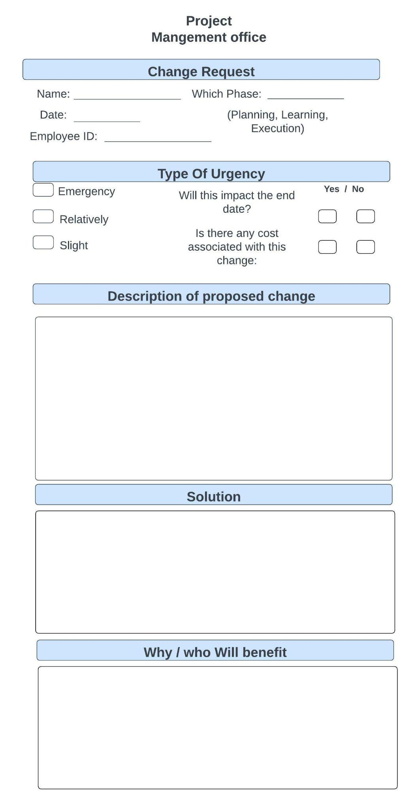
Change Request
Any sort of request or change for the implementation must be filled out via this form
Depending on the
Cost
Urgency
Time
Impact
Will the change be taken into consideration
All request will include the PM
Any significant change will need a signature of
Sponsors
Steering committee
Stakeholders

Slide 12
Key Roles and Responsibilities
Role | Responsibility
Project Manager | Responsible for all project planning, including defining tasks and estimating efforts. Ensures successful implementation of salesforce using proper resource allocation, communication skills, and knowledge of appropriate project management methodologies. Also responsible for approving the project, allocating funds, and clearing major issues.
Systems Analyst | Analyze the business case for a Salesforce implementation to determine the needed requirements and functionality needed for our sales team. The systems analyst will ensure that the ideal solution is implemented that has both the necessary functionality and confirm the feasibility of the project.
Product Owner | Work in conjunction with the systems analyst to determine system requirements and ensure that the team has an adequate understanding of the gaps that will be filled when implementing the CRM. The primary role of the product owner is ensuring that the needs of the sales team are clearly communicated and that the correct system requirements are being prioritized.
System Administrator | This team member is tasked with the role of administration of the CRM. This will involve things like configuration and technology management. It is the system administrator’s responsibility to make sure that Zippy publishing has the technology necessary to effectively implement Salesforce.
Trainer | Training the sales team on using the newly implemented CRM and ensure that they are able to effectively leverage the software to achieve the desired results.

Slide 13
Managing and Controlling The Project
Project success is determined by proper balancing of scope, cost, and time to complete. We will be using the following methods to ensure the project is always properly controlled and monitored:
We will conduct an Earned value analysis to measure the value of the CRM over time
We will put a formal process in place for change requests
We will have formal acceptance of completed project deliverables
We will have an approved scope baseline
We will monitor the quality of all deliverables with a formal review meeting attended by all stakeholders
With the proper monitoring and control in place, we can be confident that this project has a high likelihood of success.

Slide 14
Estimated Effort and Risks
This project is estimated to have low to moderate risk. We used probability and impact qualitative analysis to identify the risks we needed to prioritize. We will escalate the high-level risks to upper management. The primary risks are as follows:
CRM being unreliable
Sales employees refusing to use the software
CRM data breaches
Employees not being able to leverage the software effectively
The risk will be mitigated by:
Thorough research on reliability before implementing CRM
Thorough training to ensure that all employees are able to effectively leverage the CRM
Ensuring the project manager has the authority to make tactical changes in the implementation of the CRM
With the analysis we have in place, we are confident that we can implement the CRM without issue

Slide 15
Recommendation
With the features of Salesforce Professional highlighted this will help impact
No delays in eBook deliveries
Consistent and streamlined communication with customer and other knowledge leaders within Zippy Publishing
Features that will help leverage and efficiently place employees
The features of Salesforce Professional will given will help employees better utilize themselves
Consistent increase in new customer relationships - with a goal of at least five new customers every other week and one new author available for purchase
Better manage who has what leads or customers
Customize sales processes or documentation per customer
We have garnered a sophisticated plan of action for the CRM implementation
Given a time frame for gathering funding, while giving a time frame for those the time to learn and utilize the CRM.
This project will bring more value to Zippy Publishing as a company and begin the track to resolve core organizational faults. Implementing Salesforce Professional allows Zippy Publishing to utilize a vast amount of resources to solve the problems weighing Zippy down all these years. The features and modules in Salesforce professional will give its employees the correct tools to streamline profitability, leverage its employees, and communicate effectively with its clientele.

Slide 16
Thank you!
We hope you enjoyed and can see the potential success in our CRM implementation plans.

